Slide 1
DIGITAL WATERMARKING
TASKS DONE :
1.Downloading the eclipse NEON IDE and JDK
2.INSTALLING IDE AND JAVA
3.Setting the path of JDK for accessing the development tools
4.EXECUTING SAMPLE PROGRAMS :
A.MIRROR IMAGES
B.RANDOM PIXEL IMAGES
C.TRANSFORMING THE RANDOM PIXEL IMAGE BY ADDING BLUE COLOUR LAYERS
D.ACCESSING EACH PIXEL OF AN IMAGE INDIVIDUALLY AND COUNTING IT.

Slide 2

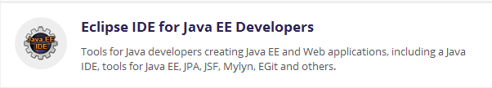
SETTING UP THE ENVIRONMENT

Slide 3
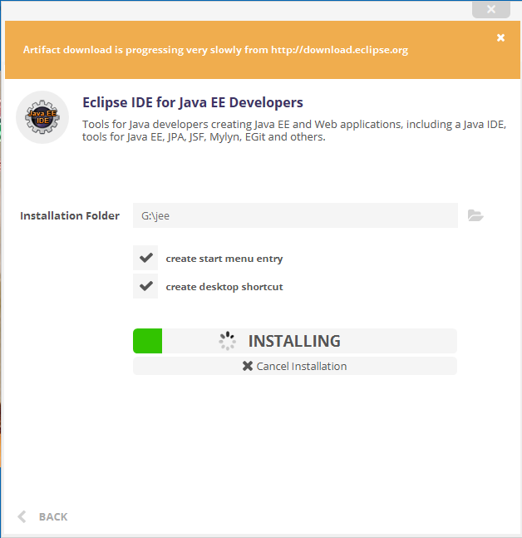
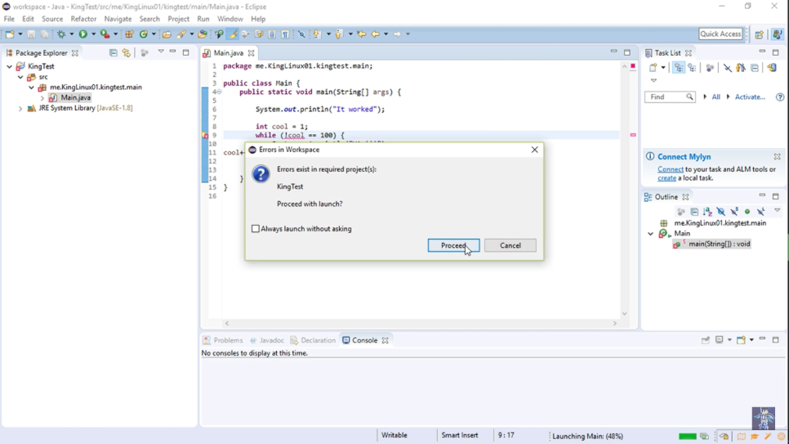
A BASIC JAVA PROGRAM

Slide 4
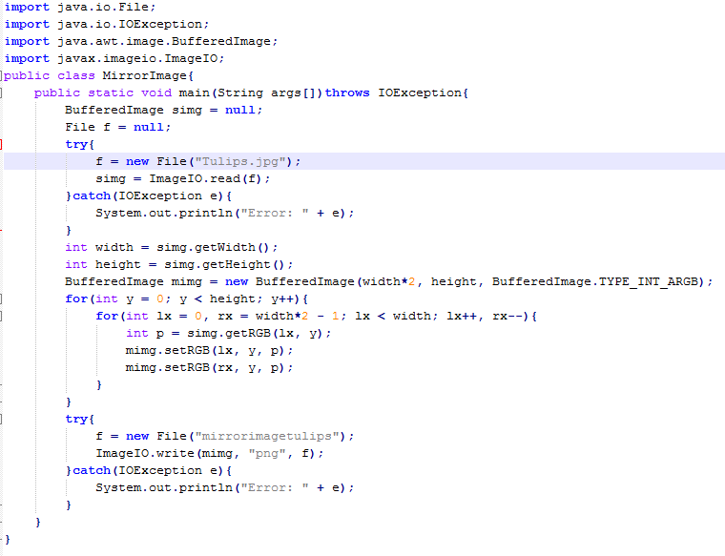
Mirrorimage.java

Slide 5
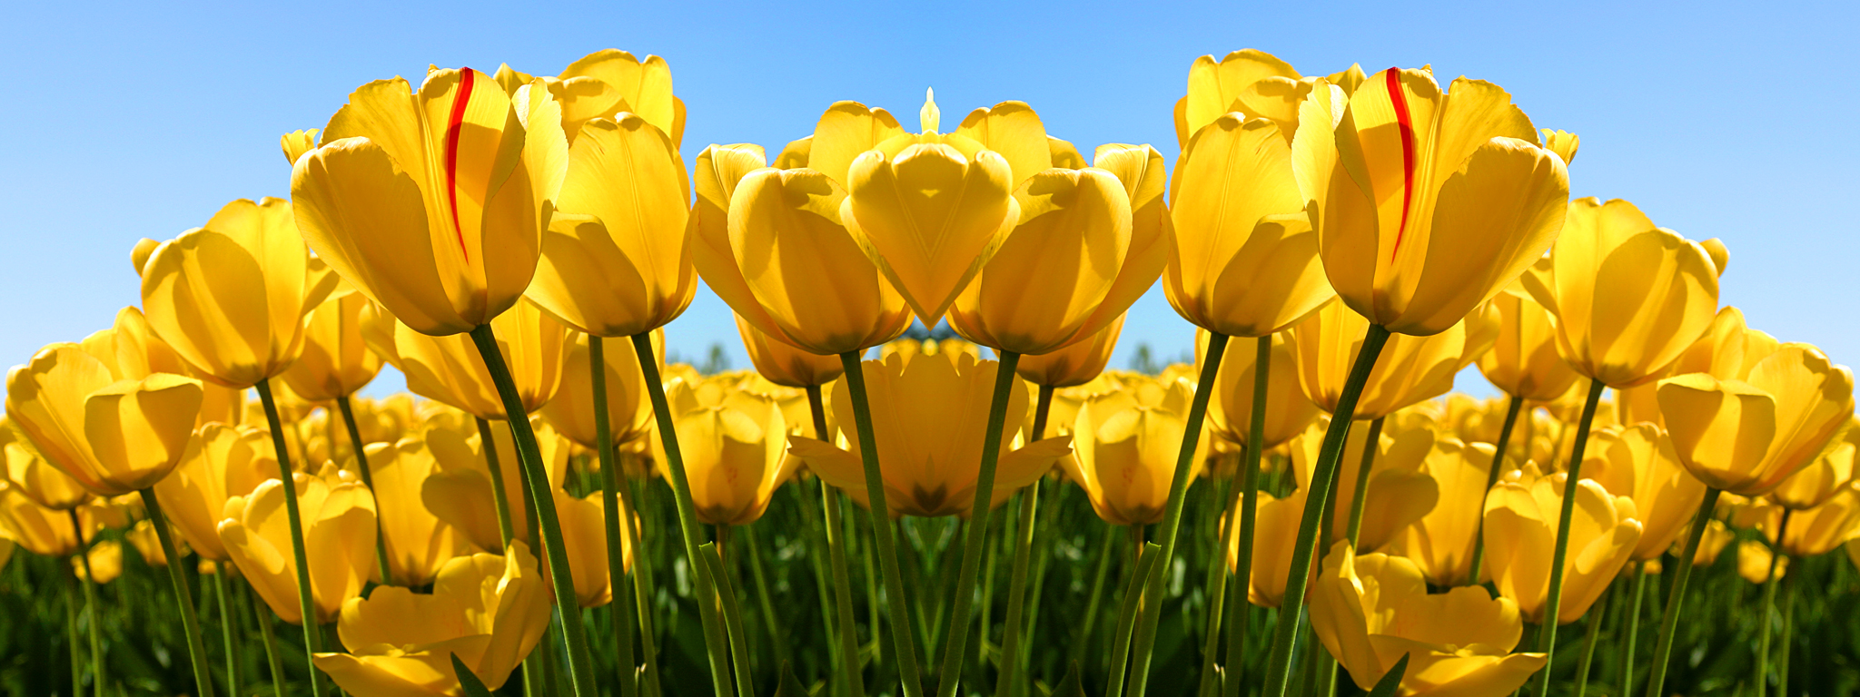
output

Slide 6
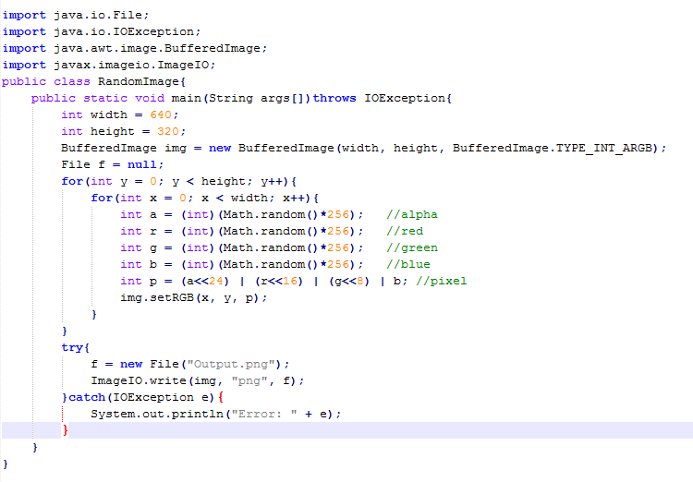
Random colour pixels

Slide 7

output

